Slide 1
E-360-CHATBOT
By SANJEEV
thenkara@msu.edu
CSE-841 : Artificial Intelligence
Professor: Dr. Kevin Liu

Slide 2
CONTENTS
1. Introduction and motivation
2. Problem Statement
3. Algorithmic details and software implementation details
4. Experimental design and datasets
5. Results
6. Inference Performance
7. Conclusions &Future work

Slide 3
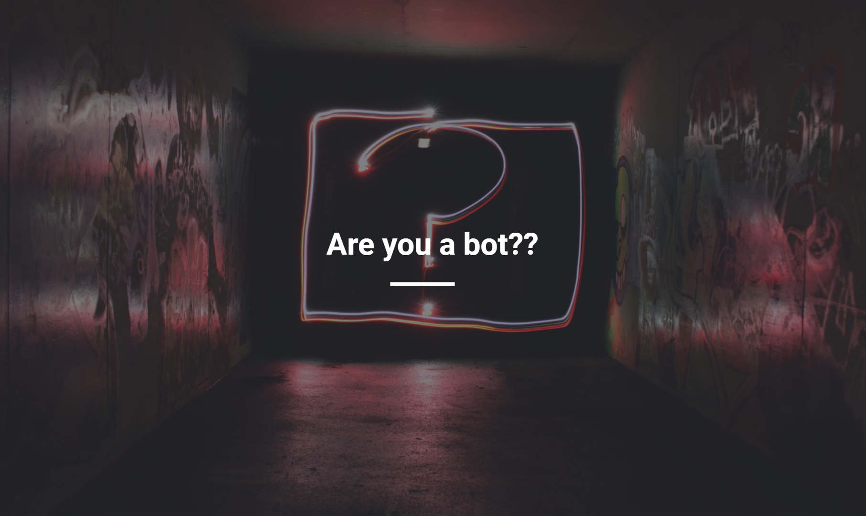
Introduction & Motivation

Slide 4
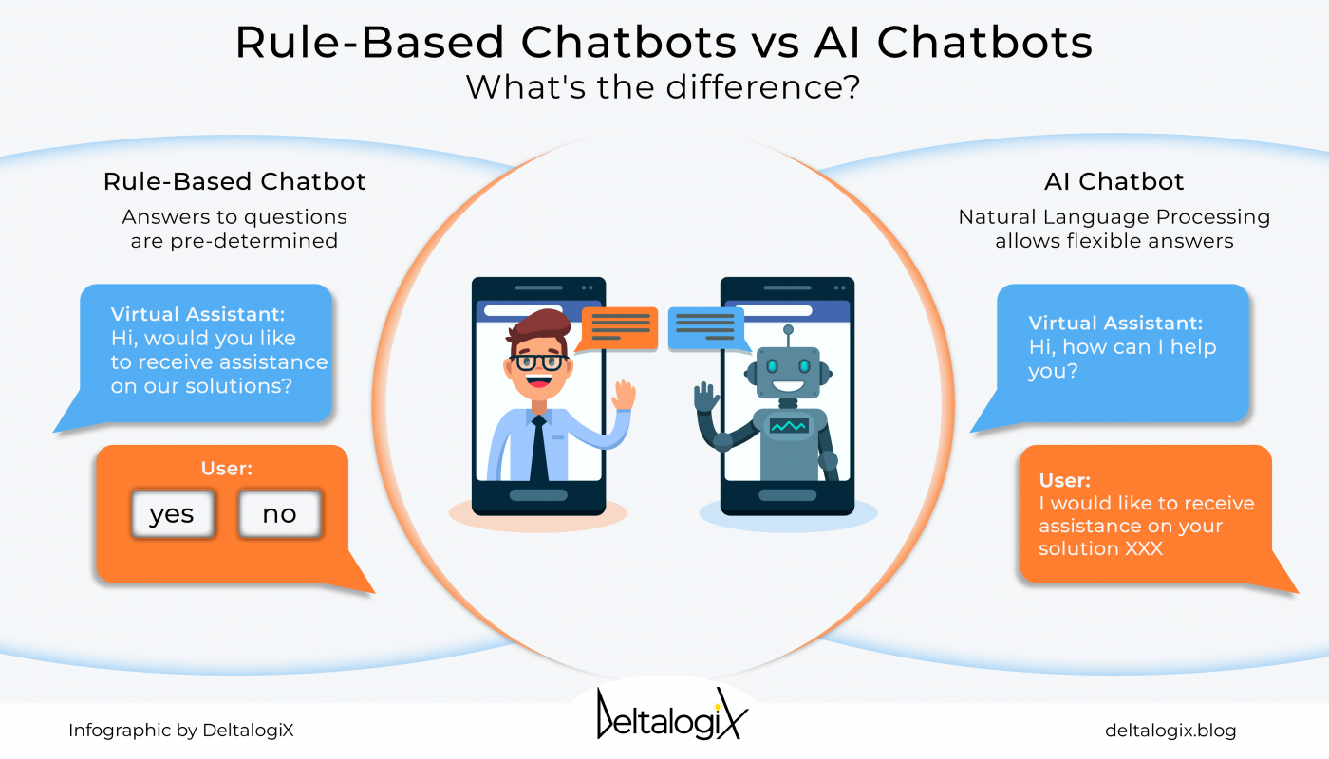
How Chatbots work
Chatbots are basically of 2 types:
a. Simple Rule Based
b. Generative Based(AI)
https://www.formilla.com/blog/types-chat-bots/

Slide 5

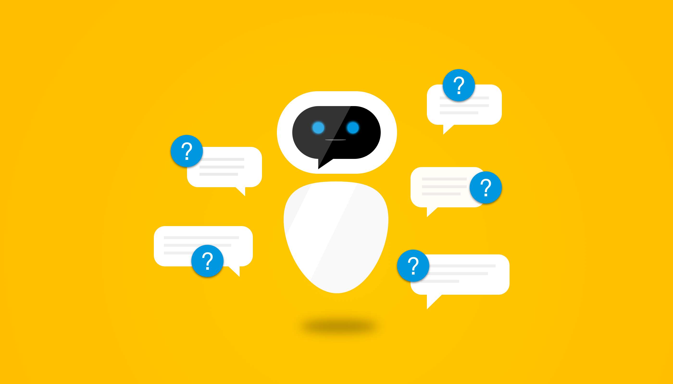
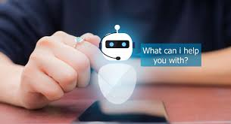

Use-cases:
1. Customer Support 24X7
2. FAQ’s
3. Addressing grievances
4. Scheduling Appointment
5. Raising tickets to testing team to resolve issue
To Build a Successful Chatbot…. Start with these 5 questions. | by Yogesh Moorjani | Chatbots Magazine

Slide 6
Problem Statement
The main objective of the proposal is to design an autonomous AI chatbot(infuses uses of NLP) that can be utilized to generate intellectual cohesive response to the user in return in different domains ranging from education sector, Healthcare, E-commerce sector & Retail
&
implement various models(such as LSTM-RNN,Seq2Seq-Attention Model-Transformers) to the given dataset & compare the performance results on Real life scenario.

Slide 7
dataset
The Cornell Movie-Dialogs Corpus is a rich dataset of movie character dialog:
220,579 conversational exchanges between 10,292 pairs of movie characters
9,035 characters from 617 movies
304,713 total utterances
Supplementary datasets pertaining to the relevant domain have been employed.
a. Movie lines .txt (raw-data) b. Conversations.txt(raw data)

Slide 8
Basic Architecture Flow
Preprocessing
EDA
MODEL IMPLEMENTATION
TRAINING
RESULTS-ACCURACY
DEMO-Snapshot OF CHATBOT RUNNING

Slide 9
EDA & preprocessing
Movie_lines.txt
Conv.txt
CleansedLines.txt
CleansedConv.txt
Questions
Answers
Vocab

Slide 10
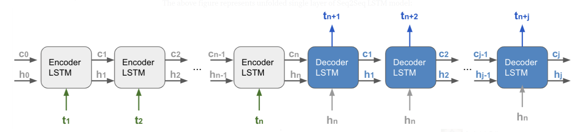
MODEL Implementation
LSTM-RNN BASED Seq2Seq Model
C_{w}
https://levelup.gitconnected.com/building-seq2seq-lstm-with-luong-attention-in-keras-for-time-series-forecasting-1ee00958decb

Slide 11
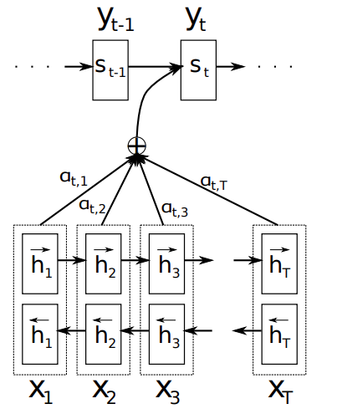
Model Implementation(Contd.)
ATTENTION BASED Seq 2 Seq Model:
1409.0473.pdf (arxiv.org)

Slide 12
System & Software Specifications
System | Specification
CPU | Model name: Intel(R) Xeon(R) CPU @ 2.00GHz
GPU | Tesla P100-PCIE-16GB
SOFTWARE | Linux OS, TensorFlow version-1.7.0-rc1

Slide 13
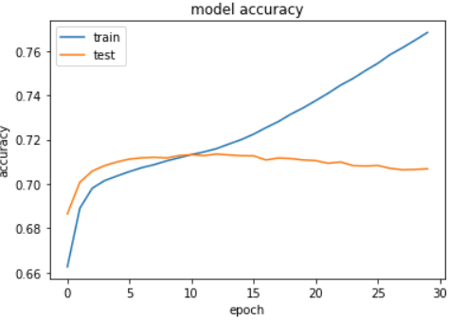
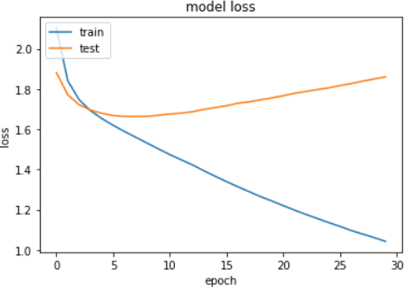
Analysis & metrics
fig(a) fig(b)
Fig (a) & (b) : LSTM-RNN-Seq2Seq Model performance

Slide 14
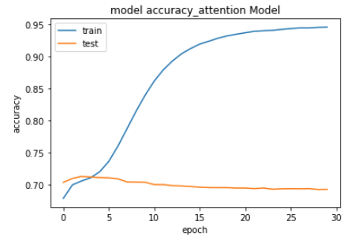
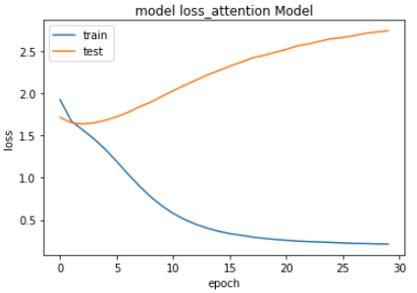
fig(c) fig(d)
Fig (c) & (d): ATTENTION-Based-Seq2Seq Model performance

Slide 15
Results
epochs | Train Accuracy | ValidationAccuracy | Training Loss | Validation Loss
1. LSTM-RNN –BASED-Seq2Seq | ---------------------- | -------------------------------- | --------------------- | -------------------------
10 | 0.7111 | 0.7043 | 1.495 | 1.667
30 | 0.7683 | 0.7068 | 1.154 | 1.874
2. ATTENTION-BASED-Seq2Seq | ---------------------- | -------------------------------- | --------------------- | -------------------------
10 | 0.8396 | 0.7040 | 0.7749 | 1.961
30 | 0.9452 | 0.7053 | 0.2144 | 2.503

Slide 16
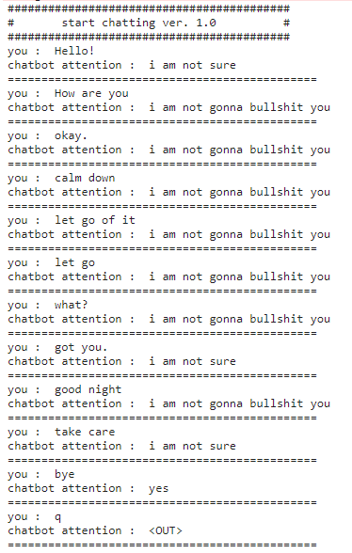
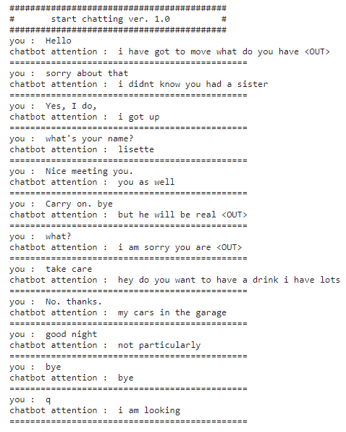
Inference performance of chatbot with Human
LSTM-RNN based inference
Attention based inference

Slide 17
Conclusion & Future Work
Thus we observe significant improvement in the area of performance with regards to the Attention Based Seq2Seq model than that of the former.
The response from the Attention Based Chatbot model performs more superior and preserves the context of the sentence.
In the future proceedings, this project can be extended to work with pretrained models such as:
GPT-3,
BERT
To achieve better accuracy & Coherence during conversation, with tradeoff of being Computational Expensive.

Slide 18
relevant work & References
1.Manyu Dhyani, Rajiv Kumar,An intelligent Chatbot using deep learning with Bidirectional RNN and
attention model,Materials Today: Proceedings,Volume 34, Part 3,2021,Pages 817-824,ISSN 2214-7853
2. Eric W.T. Ngai, Maggie C. M. Lee, Mei Luo, Patrick S.L. Chan, Tenglu Liang,An Intelligent Knowledge based
Chatbot for Customer Service,Electronic Commerce Research and Applications,2021,101098,ISSN
1567-4223,
3. Chatbot Tutorial — PyTorch Tutorials 1.10.0+cu102 documentation
GitHub Link
→Github Repo: sanjeev777666/AI-Project: AI-CSE841 (github.com)

Slide 19
THANK YOU

